Slide 1
Image Processing for Computer Vision Applications(1)
Nanik Suciati
nanik@if.its.ac.id

Slide 2
References
Chapter 3, Digital Image Processing, 2nd edition, Rafael C. Gonzalez.
Chapter 3, Computer Vision: Algorithms and Applications, Richard Szeliski.

Slide 3
Overview
We will look at the first stage in most computer vision applications, namely the use of image processing to preprocess the image and convert it into a form suitable for further analysis.
Examples of such operations:
color balancing,
reduction of image noise,
increasing sharpness,
straightening the image by rotating it.

Slide 4
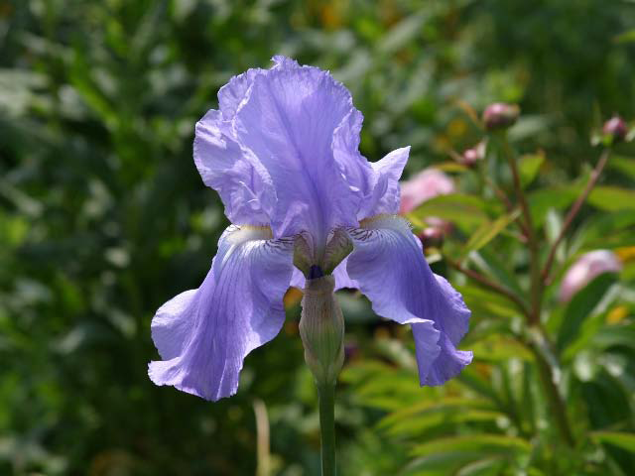
Original Image

Slide 5
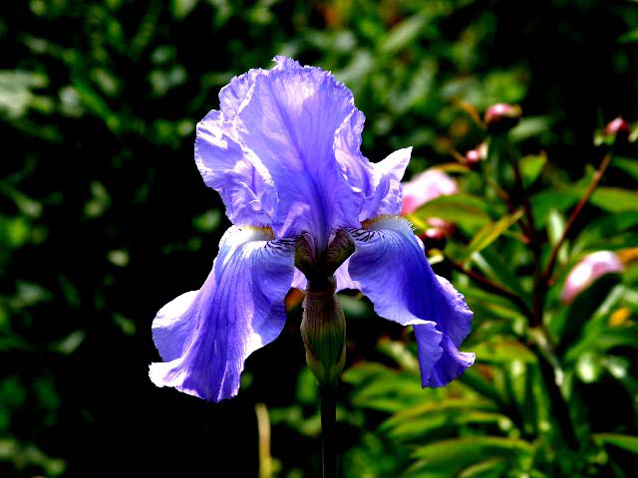
Increased Contrast

Slide 6
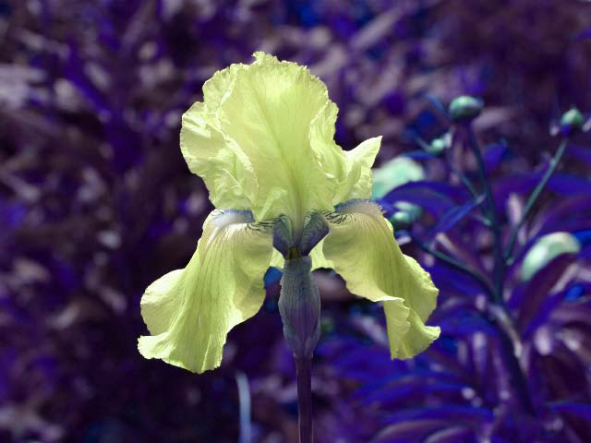
Change in hue

Slide 7
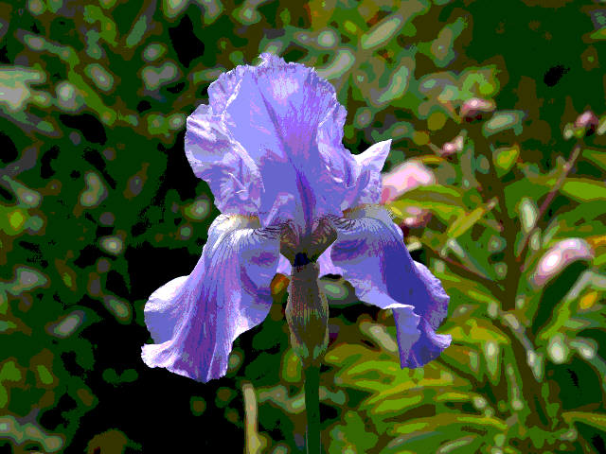
“posterized” (quantized colors)

Slide 8

blurred

Slide 9
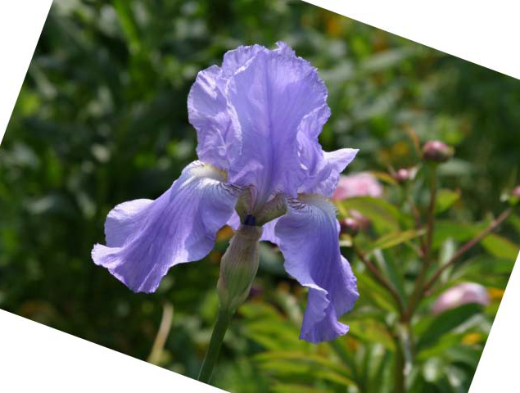
rotated

Slide 10
Outline
Image processing in the spatial domain
Basic gray level transformations
Histogram processing
Arithmetic/Logic operations
Linear Filtering
Image processing in the frequency domain
Fourier transforms
Color image processing
Wavelets and Multiresolution processing
Morphological image processing

Slide 11
Preview
Spatial domain processing techniques are based on direct manipulation of pixels in an image.
Frequency domain processing techniques are based on modifying the Fourier transform of an image.

Slide 12
Background
Spatial domain processes will denoted by the expression :
g(x,y) = T [ f(x,y) ]
f(x,y) is the input image
g(x,y) is the output image
T is an operator on f, defined over some neighborhood of (x,y).

Slide 13
Background
The principal approach in defining a neighborhood about a point (x,y) is to use a rectangular subimage area centered at (x,y).
The center of the subimage is moved from pixel to pixel starting, say, at the top left corner.
The operator T is applied at each location (x,y) to yield the output g, at that location.
The process utilizes only the pixels in the area of the image spanned by the neighborhood.

Slide 14
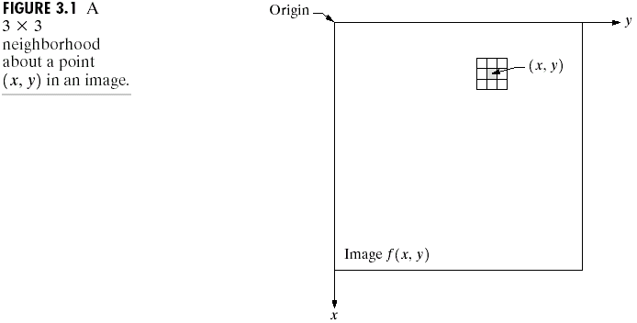
Background

Slide 15
Background
The simplest form of T is when the neighborhood is of size 1x1 (single pixel).
In this case, g depends only on the value of f at (x,y), and T becomes a gray-level (or intensity or mapping) transformation function of the form :
s = T(r)
r and s are variables denoting the gray level of f(x,y) and g(x,y) at any point (x,y).

Slide 16
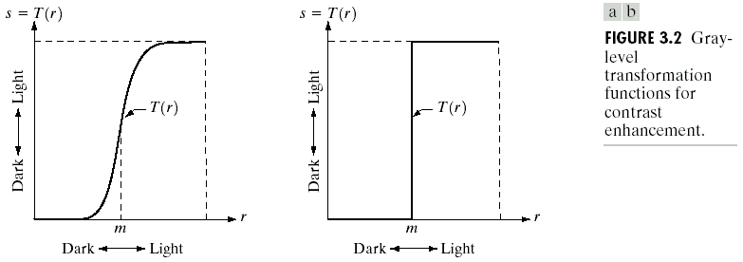
Background

Slide 17
Background
The effect of this transformation (a) would be to produce an image of higher constrast than the original by darkening the levels below m and brightening the levels above m in the original image.
This technique is known as contrast stretching, the values of r below m are compressed by the transformation function into a narrow range of s, toward black. The opposite effect takes place for values of r above m.

Slide 18
Background
This transformation T(r) [b] produces a two-level (binary) image.
A mapping of this form is called a thresholding function.
Point processing is a technique which enhancement at any point in an image depends only on the gray level at that point.

Slide 19
Background
Larger neighborhood allow considerably more flexibility. The general approach is to use a function of the values of f in a predefined neighborhood of (x,y) to determine the value of g at (x,y). One of the principal approaches in this formulation is based on the use of so-called masks (also referred to as filters, kernels, templates, or windows). Basically, a mask is a small (say, 3x3) 2-D array, in which the values of the mask coefficients determine the nature of the process. Enhancement techniques based on this type of approach often are referred to as mask processing or filtering.

Slide 20
Basic Gray Level Transformations

Slide 21
Some Basic Gray Level Transformations
There are three basic types of gray-level transformations which are used frequently for image enhancement :
Linear (negative and identity transformations)
Logarithmic (log and inverse-log transformations)
Power-law (nth power and nth root transformations)

Slide 22
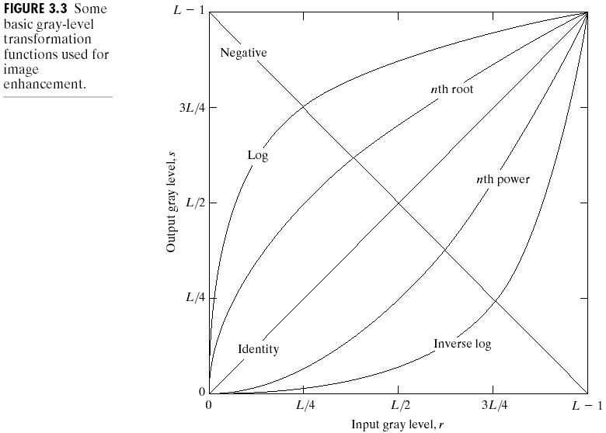
Some Basic Gray Level Transformations

Slide 23
Image Negatives
The negative of an image with gray levels in the range [0, L-1] is obtained by using the negative transformation which is given by the expression :
s = L – 1 – r
Reversing the intensity levels of an image in this manner produces the equivalent of a photographic negative.
This type of processing is suited for enhancing white or gray detail embedded in dark regions of an image, especially when the black areas are dominant in size.

Slide 24
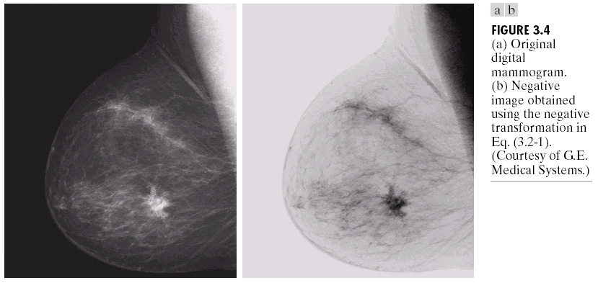
Image Negatives

Slide 25
Log Transformations
The general form of the log transformation is:
s = c log (1+r)
where c is a constant, and it is assumed that r ≥ 0.
This transformation maps a narrow range of low gray-level values in the input image into a wider range of output levels. The opposite is true of higher values of input levels.
We would use a transformation of this type to expand the values of dark pixels in an image while compressing the higher-level values. The opposite is true of the inverse log transformation.

Slide 26
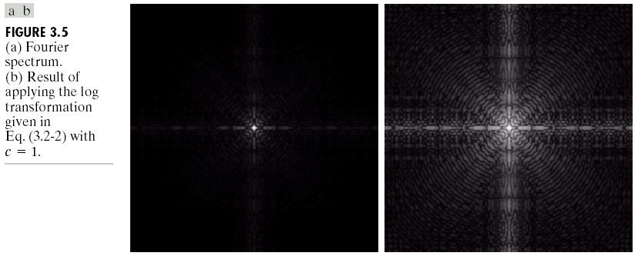
Log Transformations

Slide 27
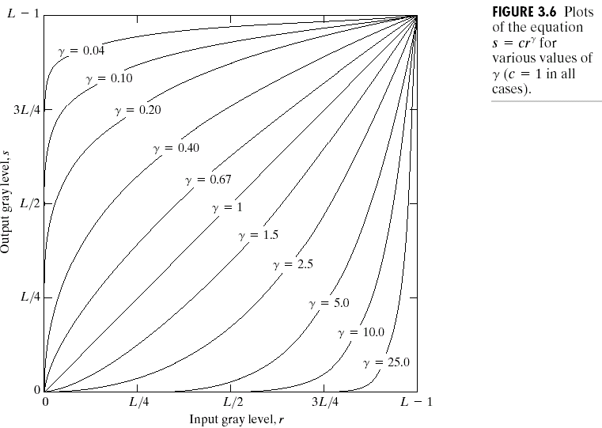
Power-Law Transformations
Power-law transformations have the basic form :
s = cr^{γ}
where c and γ are positive constants.

Slide 28
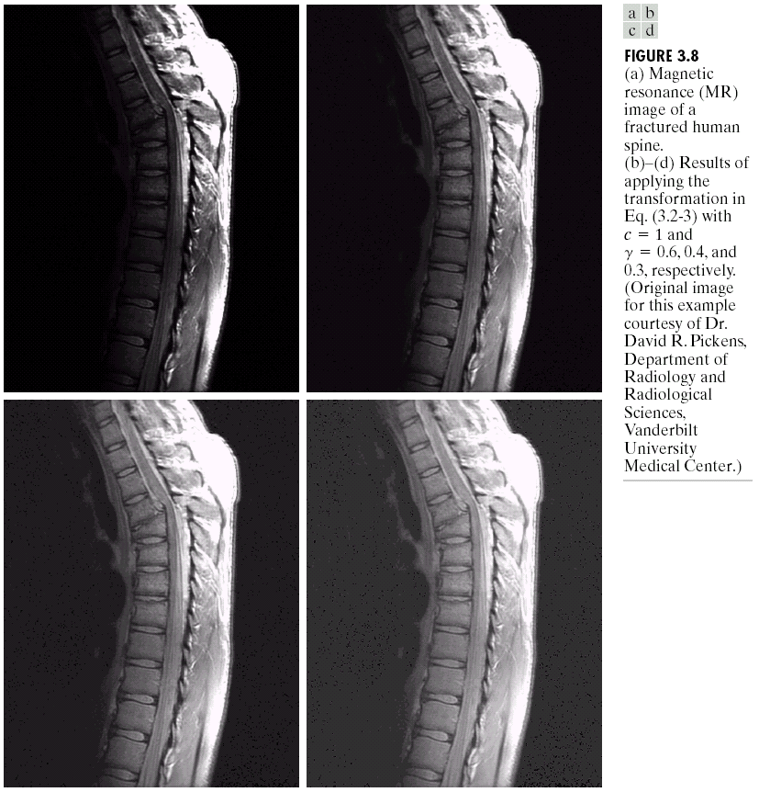
Power-Law Transformations

Slide 29
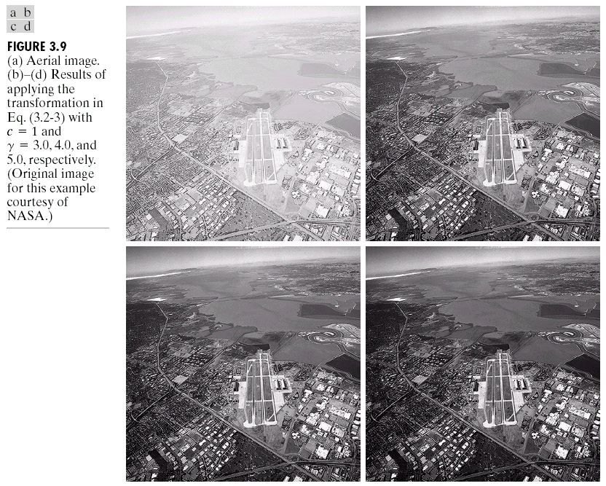
Power-Law Transformations

Slide 30
Histogram Processing

Slide 31
Histogram Processing
The histogram of a digital image with gray levels in the range [0...L-1] is a discrete function h(r_{k})=n_{k}, where r_{k} is the kth gray level and n_{k} is the number of pixels in the image having gray level r_{k}.
It is common practice to normalize a histogram by dividing each of its values by the total number of pixels in the image, denoted by n. Thus, a normalized histogram is given by p(r_{k})= n_{k}/n, for k=0,1,…,L-1.
p(r_{k}) gives an estimate of the probability of occurrence of gray level r_{k}. Note that the sum of all components of a normalized histogram is equal to 1.

Slide 32
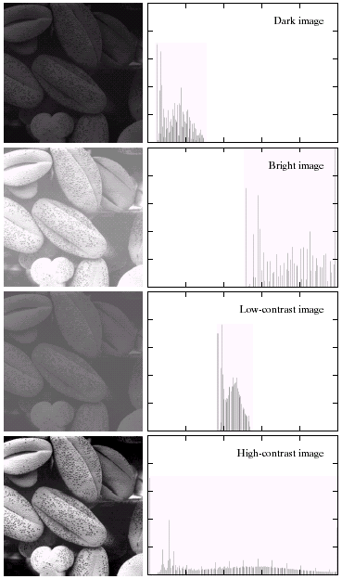
Histogram Processing
Four basic image types: dark, light, low, and high contrast, and their coresponding histograms.

Slide 33
Histogram Processing
The horizontal axis of each histograms corresponds to gray level values, r_{k}. The vertical axis corresponds to values of h(r_{k})=n_{k} or p(r_{k}) = n_{k}/n if the values are normalized.
Histograms are the basis for numerous spatial domain processing techniques, such as image enhancement, compression and segmentation.

Slide 34
Histogram Equalization
Histogram equalization is used to increase the width of the input gray-level range, so it will increase the contrast of input image.
The transformation below :
for k=0,1,2,…,L-1;
is called histogram equalization or histogram linearization.

Slide 35
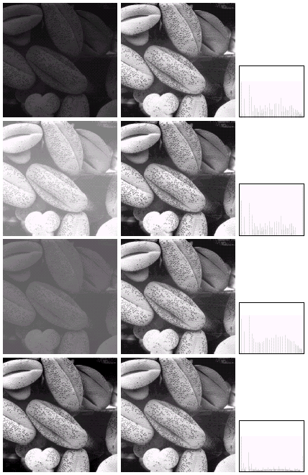
Histogram Equalization

Slide 36
Local Enhancement
The histogram processing methods discussed in the previous two sections are global, in the sense that pixels are modified by a transformation function based on the gray-level content of an entire image.
Sometimes, there are cases in which it is necessary to enhance details over small area in an image.

Slide 37
Local Enhancement
The histogram processing techniques previously described are easily adaptable to local enhancement.
The procedure is to define a rectangular neighborhood and move the center of this area from pixel to pixel. At each location, the histogram of the points in the neighborhood is computed and either a histogram equalization or histogram specification transformation function is obtained. This function is finally used to map the gray level of the pixel centered in the neighborhood. The center of the neighborhood region is then moved to an adjacent pixel location and the procedure is repeated.

Slide 38
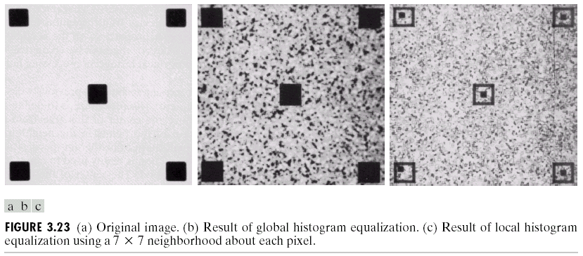
Local Enhancement

Slide 39
Use of Histogram Statistics for Image Enhancement
Instead of using the image histogram directly for enhancement, we can use instead some statistical parameters obtainable directly from the histogram. In terms of enhancement, however, we are interested primarily in the mean, which is a measure of average gray level in an image, and the variance (or standard deviation), which is a measure of average contrast. Standard deviation is defined simply as the square root of the variance.

Slide 40
Use of Histogram Statistics for Image Enhancement
Let r denote a discrete random variable representing discrete gray-levels in the range [0, L-1], and let p(r_{i}) denote the normalized histogram component corres-ponding to the i-th value of r_{i}. We may view p(r_{i}) as an estimate of the probability of occurrence of gray level r_{i}.
The mean value of r is described below :
The variance of r is described below :

Slide 41
Use of Histogram Statistics for Image Enhancement
The global mean and variance are measured over an entire image and are usefull primarily for adjustment of overall intensity and contrast.
The local mean and variance are used as the basis for making changes that depend on image characteristics in a predefined region about each pixel in the image.

Slide 42
Use of Histogram Statistics for Image Enhancement
Let (x,y) be the coordinates of a pixel in an image, and let S_{xy} denote a neighborhood (subimage) of specified size, centered at (x,y). The mean value m_{sxy}, of the pixels in S_{xy} can be computed using the expression :
where r_{s,t} is the gray level at coordinates (s,t) in the neighborhood, and p(r_{s,t}) is the neighborhood normalized histogram component corresponding to that value of gray level.

Slide 43
Use of Histogram Statistics for Image Enhancement
The gray-level variance of the pixels in region S_{xy} is given by :
The local mean is a measure of average gray level in neighborhood S_{xy} and the variance is a measure of contrast in that neighborhood.

Slide 44
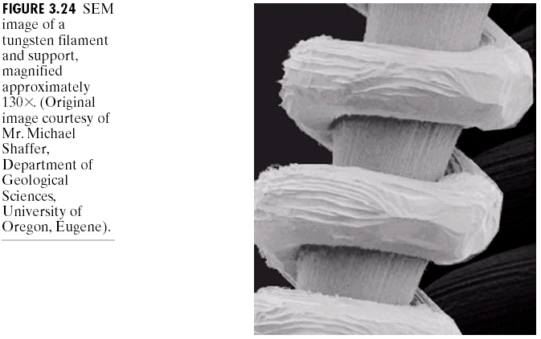
Use of Histogram Statistics for Image Enhancement
The problem is to enhance dark areas while leaving the light area as unchanged as possible since it does not require enhancement.

Slide 45
Use of Histogram Statistics for Image Enhancement
Let f(x,y) represent the value of an image pixel at any image coordinates (x,y), and let g(x,y) represent the corresponding enhanced pixel at those coordinates. Then:
g(x,y)=E. f(x,y) if m_{sxy}≤ k₀M_{G}
AND k₁D_{G} ≤ σ_{sxy} ≤ k₂D_{G}
g(x,y)=f(x,y) otherwise
where, E, k₀, k₁, k₂ are specified parameters. M_{G} is the global mean of the input image; and D_{G} is its global standard deviation.

Slide 46
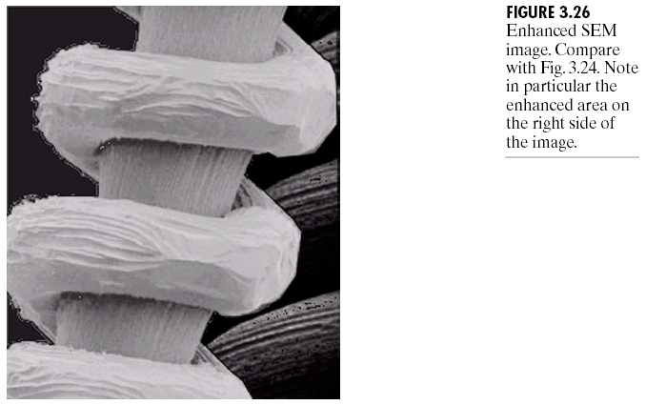
Use of Histogram Statistics for Image Enhancement
Enhanced image with E=4.0, k₀=0.4, k₁=0.02, k₀ k₂=0.4 and a small (3x3) local region.

Slide 47
Arithmetic and Logic Operations

Slide 48
Outline
Image processing in the spatial domain
Basic gray level transformations
Histogram processing
Arithmetic/Logic operations
Linear Filtering
Image processing in the frequency domain
Fourier transforms
Color image processing
Wavelets and Multiresolution processing
Morphological image processing

Slide 49
Enhancement Using Arithmetic/Logic Operations
Arithmetic/logic operations involving images are performed on a pixel-by-pixel basis between two or more images (this excludes the logic operation NOT, which is performed on a single image).
The NOT logic operator performs the same function as the negative transformation.
The AND and OR operations are used for masking; that is, for selecting subimages in an image.

Slide 50
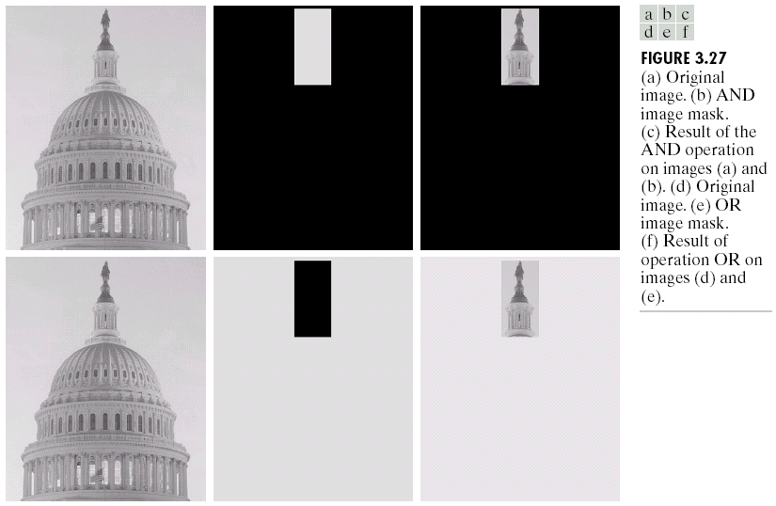
Enhancement Using Arithmetic/Logic Operations

Slide 51
Image Subtraction
The difference between two images f(x,y) and h(x,y), expressed as :
g(x,y) = f(x,y) – h(x,y)
is obtained by computing the difference between all pairs of corresponding pixels from f and h.

Slide 52
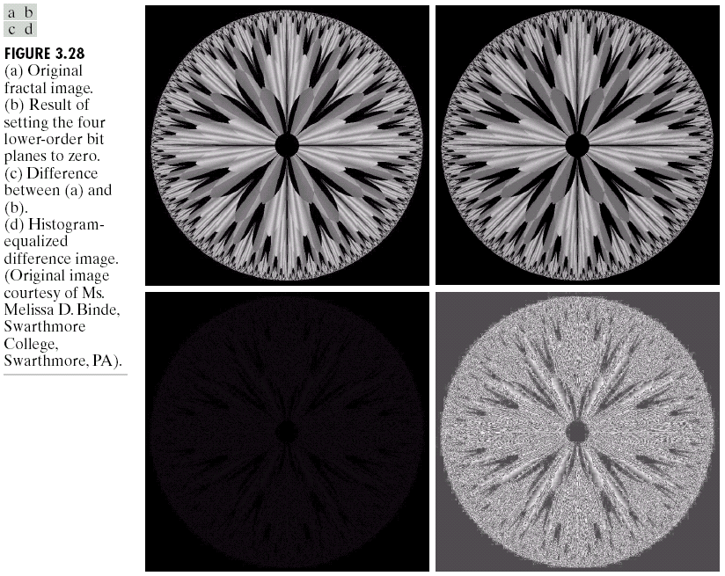
Image Subtraction

Slide 53
Image Subtraction
In practice, most images are displayed using 8 bits [0…255]. We need to scale the difference image whose values are below 0. There are 2 approches :
Add 255 to every pixel and then divide by 2.
Add the negative of the mininum difference to all pixels in the difference image. Then, all the pixels in the image are scaled to the interval [0,255] by multiplying each pixel by the quantity 255/Max, where Max is the maximum pixel value in the modified difference image.

Slide 54
Image Averaging
Consider a noisy image g(x,y) formed by the addition of noise η(x,y) to an original image f(x,y), that is,
g(x,y)=f(x,y)+ η(x,y)
where the assumption is that at every pair of coordinates (x,y) the noise is uncorrelated and has zero average value.
The objective of image averaging is to reduce the noise content by adding a set of noisy images, {g_{i}(x,y)}.

Slide 55
Image Averaging
If the noise satisfies the constraints just stated, it can be shown that if an image gg(x,y) is formed by averaging K different noisy images,
gg(x,y)=1/K Σ g_{i}(x,y)
then it follows that :
E{gg(x,y)} = f(x,y)
and σ²_{gg(x,y)} = 1/K σ²_{η(x,y)}
where E{gg(x,y)} is the expected value of gg, and σ²_{gg(x,y)} and σ²_{η(x,y)} are the variances of gg and η, all at coordinates (x,y). The standard deviation at any point in the average image is
σ_{gg(x,y)} = 1/√ K σ_{η(x,y)}

Slide 56
Image Averaging
As K increases, the variability (noise) of the pixel values at each location (x,y) decreases.
Because E{gg(x,y)} = f(x,y), this means that gg(x,y) approaches f(x,y) as the number of noisy images used in the averaging process increases.

Slide 57
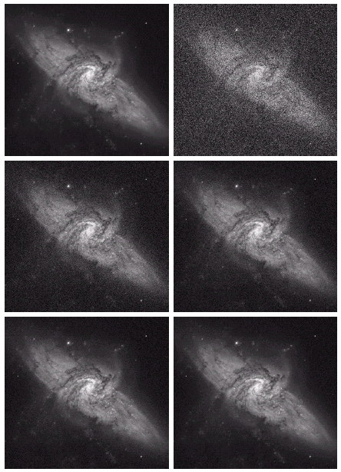
Image Averaging
Image of Galaxy Pair
Image corrupted by additive Gaussian noise with zero mean and a standard deviation of 64 gray levels.
c-f Results of averaging K=8, 16, 64 and 128 noisy images.

Slide 58
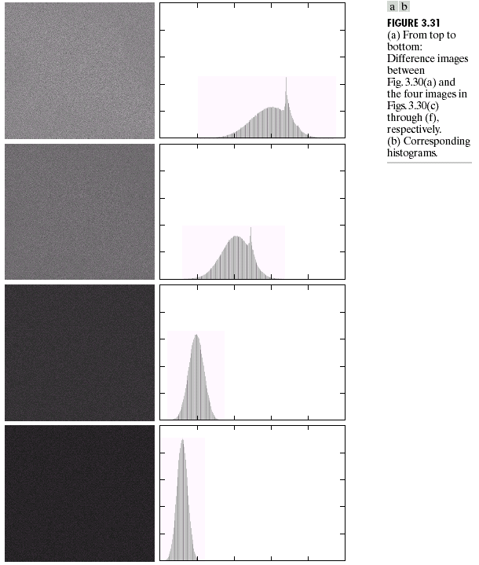
Image Averaging

Slide 59
Image Averaging
The scaling of pixel values in range [0…255] use the second method applied in the image substraction.

Slide 60
Linear Filtering

Slide 61
Basics of Spatial Filtering
The operation of spatial filtering work with the values of the image pixels in the neighborhood and the corresponding values (coefficient) of a subimage that has the same dimensions as the neighborhood (filter, mask, kernel).
For a mask of size m x n, we assume that m=2a+1 and n=2b+1, where a and b are nonnegative integers.

Slide 62
Basics of Spatial Filtering
In general, linear spatial filtering of an image f of size M x N with a filter mask of size m x n is :
g(x,y)= Σ Σ w(s,t) f(x+s,y+t)
To generate a complete filtered image, this equation must be applied for x=0,1,…,M-1 and y=0,1,…,N-1.

Slide 63
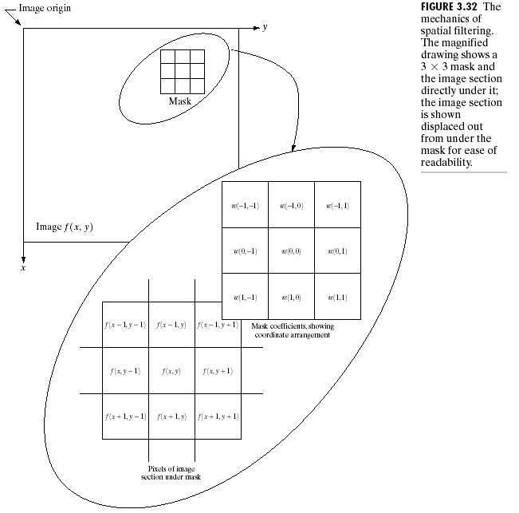
Basics of Spatial Filtering

Slide 64
Basics of Spatial Filtering
Process of linear spatial filtering is similar to a frequency domain concept called convolution.
An important consideration in implementing neighborhood operations for spatial filtering is the issue of what happens when the center of the filter approaches the border of the image. There are several ways to handle this situation :
To limit the excursions of the center of the mask to be at a distance no less than (n-1)/2 pixels from the border
To filter all pixels only with the section of the mask that is fully contained in the image.
Padding the image by adding rows and columns of 0’s or other constant gray level or padding by replicating rows or columns.

Slide 65
Smoothing Spatial Filters
Smoothing filters are used for blurring and for noise reduction.
Blurring is used in preprocessing steps, such as removal of small details from an image prior to (large) object extraction, and bridging of small gaps in lines or curves.
Noise reduction can be accomplished by blurring with a linear filter and also by non-linear filtering.

Slide 66
Smoothing Linear Filters
The output of a smoothing, linear spatial filter is simply the average of the pixels contained in the neighborhood of the filter mask. This filters sometimes are called averaging filters and also are referred to a lowpass filters.
By replacing the value of every pixel in an image by the average of the gray level in the neighborhood, this process results in an image eith reduced “sharp” transitions in gray levels.

Slide 67
Smoothing Linear Filters
Random noise typically consists of sharp transitions in gray levels, so the most obvious application of smoothing is noise reduction.
The undesireable side effect of smoothing is they blur edges (which almost always are desirable features of an image)
A major use of averaging filters is in the reduction of “irrelevant” detail in an image.

Slide 68
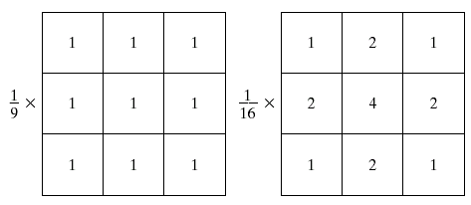
Smoothing Linear Filters
Two 3x3 smoothing (averaging) filter masks. The constant multiplier in front of each mask is equal to the sum of the values of its coefficients, as is required to compute an average.

Slide 69
Smoothing Linear Filters
The general implementation for filtering an MxN image with a weighted averaging filter of size mxn (m and n odd) is given by the expression :

Slide 70
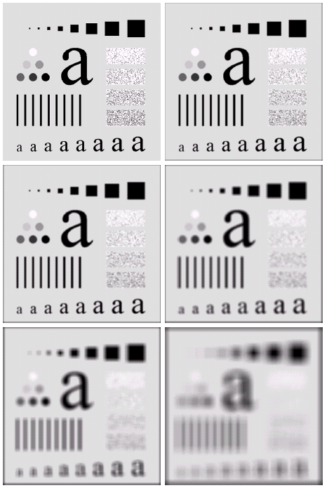
Smoothing Linear Filters
Original image of size 500 x 500 pixels.
b-f. Results of smoothing with square averaging filter masks of sizes n = 3, 5, 9, 15, and 35, respectively.

Slide 71
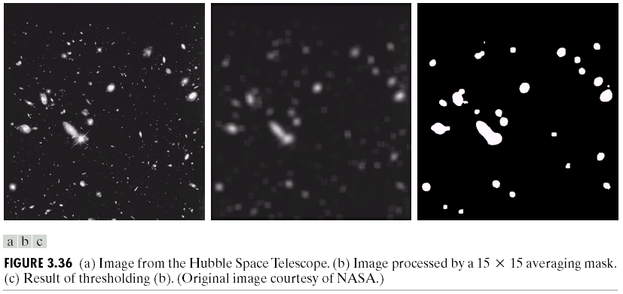
Smoothing Linear Filters
Image from the Hubble Space Telescope
Image processed by a 15 x 15 averaging mask
Result of thresholding with a threshold value equal to 25% of the highest intensity in image (b)

Slide 72
Order-Statistics Filters
Order-statistics filters are nonlinear spatial filters whose response is based on ordering (ranking) the pixels contained in the image area encompassed by the filter, and then replacing the value of the center pixel with the value determined by the ranking result.
The best-known of order-statistics filter is median filter, which replaces the value of a pixel by the median of the gray levels in the neighborhood of that pixel.

Slide 73
Order-Statistics Filters
Median filters are particularly effective in the presence of impulse noise, also called salt-and-pepper noise because of its appearance as white and black dots superimposed on an image.
The median, ξ, of a set of values is such that half the values in the set are less than or equal to ξ, and half are greater than or equal to ξ.
We first sort the values of the pixel in question and its neighbors, determine their median, and assign this value to the pixel in the center. For example, in a 3 x 3 neighborhood, the median is the 5th largest value.

Slide 74
Order-Statistics Filters
Isolated clusters of pixels that are light or dark with respect to their neighbors, and whose area is less than n²/2, are eliminated by an n x n median filter.
In other order-statistics filters, we can use 100th percentile results (max filter), which is useful in finding the brightest points in an image. Beside that, we can also use min filter and mean filter.

Slide 75
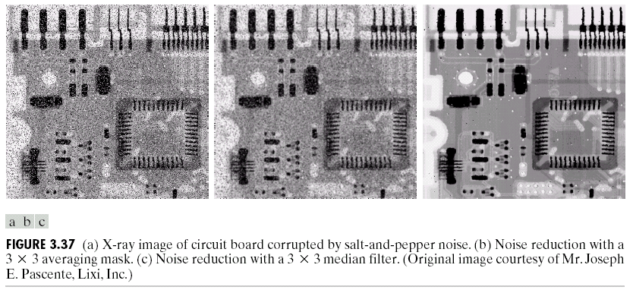
Order-Statistics Filters

Slide 76
Sharpening Spatial Filters
The principal objective of sharpening is to highlight fine detail in an imae or to enhance detail that has been blurred, either in error or as a natural effect of a particular method of image acquisition.
Image blurring could be accomplished in the spatial domain by pixel averaging in a neighborhood. Since averaging is analogous to integration, it is logical to conclude that sharpening could be accomplished by spatial differentiation.

Slide 77
Sharpening Spatial Filters
The derivatives of a digital function are defined in terms of differences. There are various way to define these differences. However, we require that any definition we use for a first derivative :
must be zero in flat segments (areas of constant gray-level values)
must be nonzero at the onset of a gray-level step or ramp
must be nonzero along ramps.

Slide 78
Sharpening Spatial Filters
Similarly, any definition of second derivative :
must be zero in flat segments
must be nonzero at the onset of a gray-level step or ramp
must be zero along ramps of constant slope.

Slide 79
Sharpening Spatial Filters
A basic definition of the first-order derivative of a one-dimensional function f(x) is the difference :
∂f/∂x = f(x+1) – f(x)
Similarly, the definition of second-order derivative is the difference :
∂²f/∂x² = f(x+1) + f(x-1) – 2f(x)

Slide 80
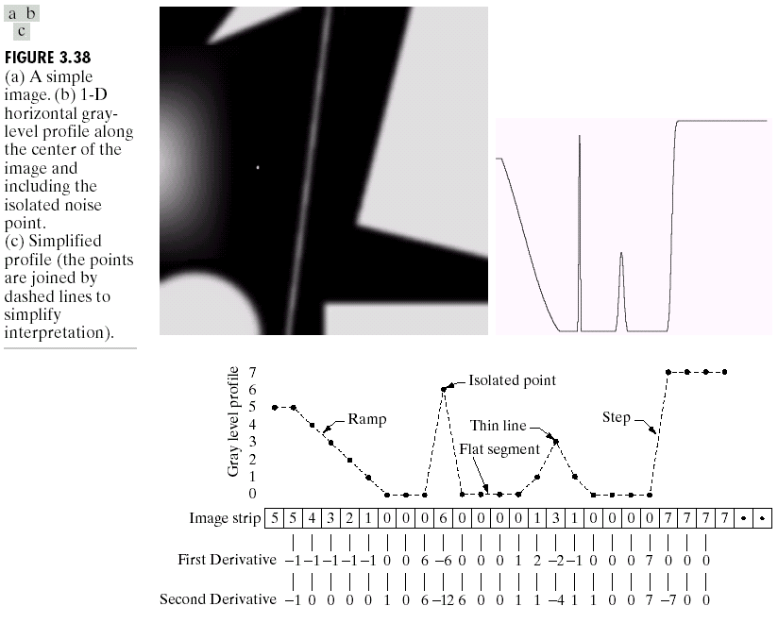
Sharpening Spatial Filters

Slide 81
Sharpening Spatial Filters
Comparing the response between first- and second-order :
FOD generally produce thicker edges in an image
SOD have a stronger response to fine detail, such as thin llines and isolated points
FOD generally have a stronger response to a gray-level step
SOD produce a double response at step changes in gray-level.

Slide 82
Sharpening Spatial Filters
In most applications, the SOD is better suited than the FOD for image enhancement because of the ability of the former to enhance fine detail.

Slide 83
Use of SOD for Enhancement – The Laplacian
The simplest isotropic derivative operator (rotation invariant) is the Laplacian, which, for a function (image) f(x,y) of two variables, is defined as :
∇²f = ∂²f/∂x² + ∂²f/∂y²
The definition for the partial SOD in the x-direction :
∂²f/∂x² = f(x+1,y)+f(x-1,y) - 2f(x,y)
and in the y-direction :
∂²f/∂y² = f(x,y+1)+f(x,y-1) - 2f(x,y)

Slide 84
Use of SOD for Enhancement – The Laplacian
The digital implementation of the 2D Laplacian :
∇²f = [f(x+1,y)+f(x-1,y)+ f(x,y+1)+f(x,y-1)] – 4f(x,y)
Background features can be “recovered” while still preserving the sharpening effect of the Laplacian operation simply by adding/subtracting the original and Laplacian images.

Slide 85
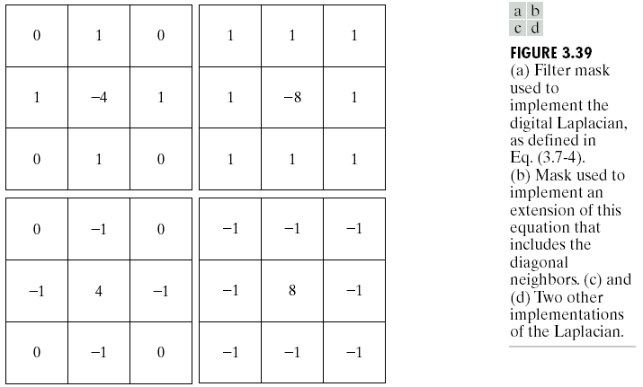
Use of SOD for Enhancement – The Laplacian

Slide 86
Use of SOD for Enhancement – The Laplacian
The basic way in which we use theLaplacian for image enhancement is as follows :
g(x,y)=f(x,y)- ∇²f(x,y), if the center coefficient of the Laplacian mask is negative.
g(x,y)=f(x,y) + ∇²f(x,y), if the center coefficient of the Laplacian mask is positive.

Slide 87
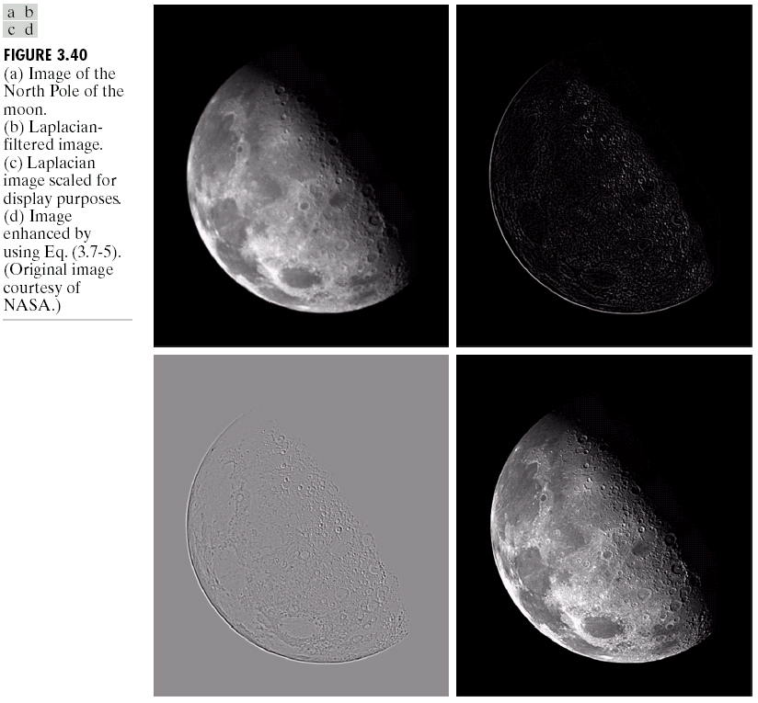
Use of SOD for Enhancement – The Laplacian

Slide 88
Unsharp masking and high-boost filtering
A process used for many years in the publishing industry to sharpen images consists of subtracting a blurred version of an image from the image itself. This process, called unsharp masking, is expressed as :
fs(x,y)=f(x,y)-fb(x,y)
where fs(x,y) denotes the sharpened image obtained by unsharp masking, and fb(x,y) is a blurred version of f(x,y).

Slide 89
Unsharp masking and high-boost filtering
A further generalization of unsharp masking is called high-boost filtering.
A high-boost filtered image, fhb, is defined as:
fhb(x,y)=Af(x,y)-fb(x,y)
where A>=a and fb is a blurred version of f.

Slide 90
Unsharp masking and high-boost filtering
Those equation may be written as :
fhb(x,y)=(A-1)f(x,y)+fs(s,y)
If we elect to use the Laplacian for image sharpening, then we can write :
fhb=Af(x,y)- ∇²f(x,y), if the center coefficient of the Laplacian mask is negative.
fhb=Af(x,y)- ∇²f(x,y), if the center coefficient of the Laplacian mask is positive.

Slide 91
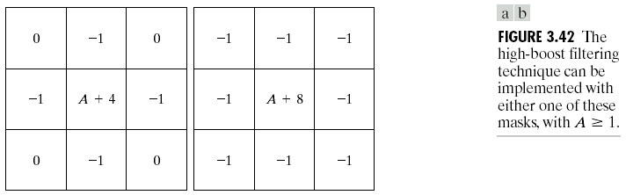
Unsharp masking and high-boost filtering
High-boost filtering can be implemented with one pass using either of the two masks above. If A=1, hbf becomes standard Laplacian sharpening. As the value of A increases past 1, the contribution of the sharpening process becomes less and less important. If A is large enough, the high-boost image will be approximately equal to the original image multiplied by a constant.

Slide 92
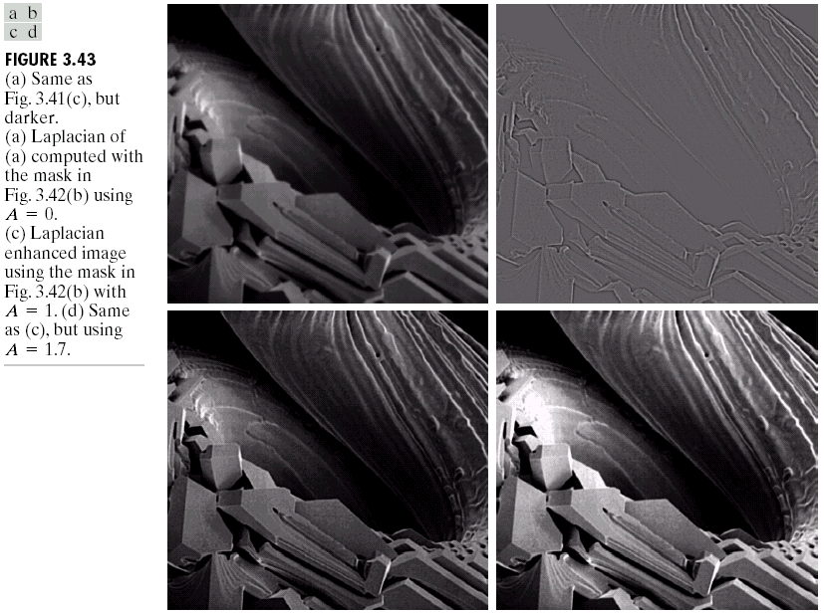
Unsharp masking and high-boost filtering

